Slide 1
PEDIATRICS NEUROLOGIC EMERGENCY

Slide 2
Outlines
Brain Anatomy and physiology
Increased Intracranial pressure(ICP)
Traumatic Brain injury
Approach to coma in Children
Childhood paralytic syndromes

Slide 3
INTRODUCTION
The brain is protected from injury by…
Scalp and skull
meninges
cerebrospinal fluid

Slide 4
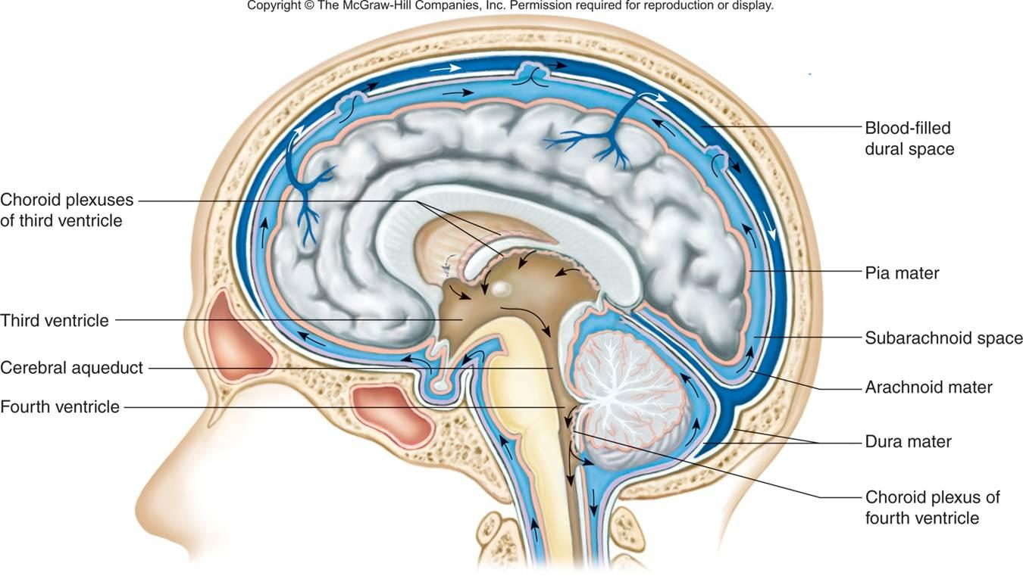
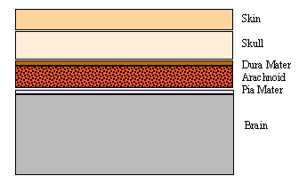
The Coverings of the Brain

Slide 5
Physiology
The brain has high metabolic demands
Total brain volume at age 1 month is approximately 36% of adult volume but by age 1 yr is approximately 72% (83% by 2 yr)

Slide 6
BRAIN METABOLISM AND CEREBRAL BLOOD FLOW
Brain oxygen consumption is about 3.5 ml /100 g/1min
25 % of the body's total oxygen consumption
90% of its energy come from glucose
Normal cerebral blood flow is approximately 55 ml /100 g/1min
15 % of the CO

Slide 7
APPROACH TO A CHILD IN COMA

Slide 8
Definition
Consciousness has two dimensions :
a) Wakefulness/arousal or alertness
b) Awareness of self and surroundings(environment)
Lethargy
- Decreased wakefulness or drowsiness
- Patient may be confused but is able to
communicate

Slide 9
Cont’d
Stupor :- Patient can be aroused with painful (noxious) stimuli
Coma (unconsciousness) refers to a state in which the patient is unable to arouse or respond to noxious stimuli
Patient is completely unaware of self & surroundings

Slide 10
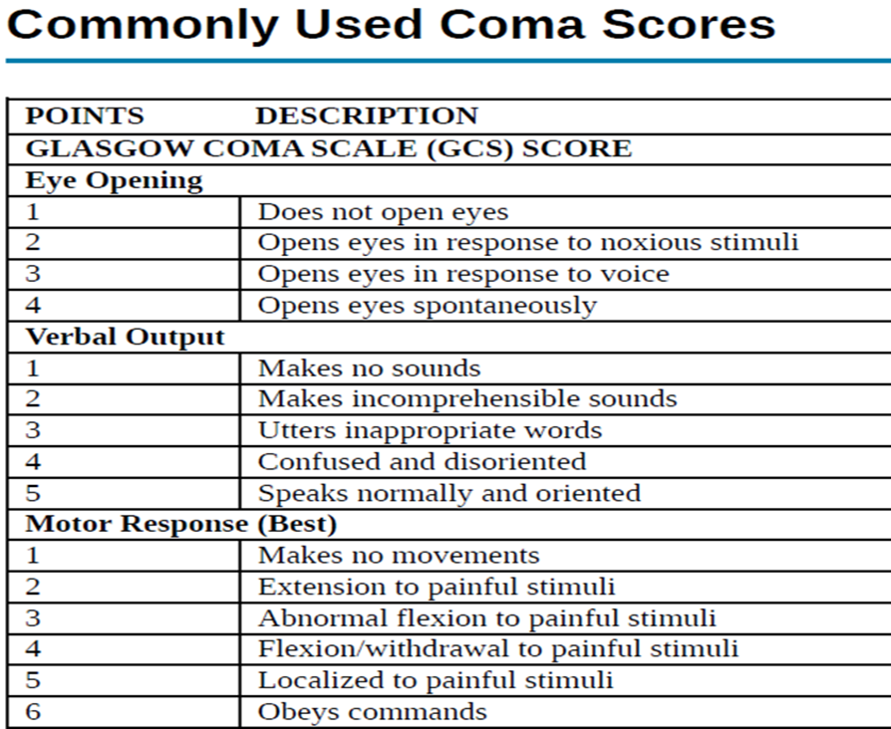
GCS ASSESMENT

Slide 11
Causes of coma
1) Metabolic (70-80%)
Hypoglycemia
Diabetes Mellitus
Renal failure
Hepatic failure
Hypothyroidism
Hypothermia
Cardiorespiratory failure
Hypoxic Encephalopathy

Slide 12
Cont’d
2) Drug over dosage (including alcohol)
3) Structural (20-30%) – diffuse & focal causes i) Diffuse
Meningitis
Encephalitis
Other infections e.g. cerebral malaria
Head injury
Epilepsy
Hypertensive encephalopathy
Subarachnoid hemmorrhage

Slide 13
Cont’d
ii) Focal
Head injury
Tumor
hemorrhage
Infarction with edema
Brain bscess

Slide 14
Approach
History of the patient
Physical examination
A) Vital sign
B) Other physical findings
C) Fundoscopy
D) Neurologic evaluation
Investigation
Management and Follow-up

Slide 15
Intracranial pressure(ICP)
The brain is confined by a rigid container, the skull.
A sustained ICP of >20mmHg is associated with a worse outcome.
Cerebral perfusion pressure = MAP – intracranial pressure

Slide 16
Cont’d
Result from swelling, masses, or increases in blood and CSF volumes.
Compensatory mechanisms decrease ICP by
Decreasing CSF volume
Decreasing cerebral blood volume
Increasing cranial volume

Slide 17
Sign and symptoms of ICP
Headache
Nausea and Vomiting
Decreased mentation
Papilledema
Sixth nerve palsy
Bulging fontanelles and splitting sutures
(in infants)

Slide 18
Traumatic Brain Injury(TBI)
Motor vehicle crashes, falls, assaults, abusive head trauma, child abuse.
Most TBIs in children are from closed-head injuries.
TBI results in primary and secondary injury.
Epidural, subdural, and parenchymal intracranial hemorrhages can result.
Focal cerebral contusions, diffuse cerebral swelling, axonal injury, and injury to the cerebellum or brainstem.

Slide 19
Classification
Minor head injury: GCS 15 with no LOC
Mild head injury: GCS 14 or 15 with LOC
Moderate head injury: GCS 9–13
Severe head injury: GCS 3–8
Critical : GCS 4 & 5

Slide 20
Clinical Manifestations
Coma is seen immediately after the injury and is sustained.
Alert on presentation but may deteriorate after a period of hours.

Slide 21
Cont’D
Increased ICP with impending herniation may be heralded by
New-onset or worsening headache, depressed level of consciousness,
Vital sign changes (hypertension, bradycardia, irregular respirations)
CNS palsy

Slide 22
Primary Head Injury
LOC occur immediately on impact
No LOC once consciousness regained
Concussion
Contusion
Diffuse axonal injury
Bleeding

Slide 23
Secondary brain injury
-Occurs after the moment
Hypoxia
Hypotension
Raised intracranial pressure (ICP)
Intracranial hematoma
Seizures
Infection

Slide 24
Management
Immediately order CT scan
Multi disciplinary involvement
Intensive care unit (ICU) monitoring(moderate and severe)
Monitoring for increased ICP
Anticonvulsant prophylaxis

Slide 25
Childhood paralytic syndromes
POLIOMYELITIS caused by Poliovirus : RNA virus
Wild-type Poliovirus
Vaccine strains of poliovirus
90-95% of infections are asymptomatic
0.1% of infected infants and 1% of infected adolescents develop paralysis
Transmission : Fecal-oral route

Slide 26
Pathogenesis
Poliovirus enters the body by mouth into GI tract
Spread to lymphatic tissues of the nasopharynx (tonsils) & intestinal wall (peyer’s patches)
Primary viremia occurs after 2-3 days
Poliovirus spreads to CNS via :
1. blood stream and
2. ? along peripheral nerves
Signs of poliomyelitis 10-14 days after infection

Slide 27
Cont’d
The poliovirus primarily infects motor neuron cells in the :
1.spinal cord (the anterior horn cells) and
2.medulla oblongata (the cranial nerve nuclei).

Slide 28
Clinical Manifestations
1) In apparent Infection
2) Abortive poliomyelitis
3) Non-paralytic poliomyelitis
4 Paralytic poliomyelitis

Slide 29
Diagnosis
Poliomyelitis should be considered in any unimmunized or incompletely immunized child with paralytic disease
VAPP should be considered in any child with paralytic disease occurring 7-14 days after receiving OPV
Definitive diagnosis is with stool culture

Slide 30
Differential Diagnosis
Guillain-Barre Syndrome
Transverse Myelitis
Traumatic Paralysis
Botulism
Myasthenia gravis

Slide 31
Guillain-Barre Syndrome
Postinfectious polyneuropathy (motor,sensory,autonomic )
Most patients have a demyelinating neuropathy
Involves all age group

Slide 32
Clinical manifestations
Paralysis usually follows a non-specific viral infection by about 10 days
Mycoplasma pneumoniae ,Campylobacter jejuni ,H.pylori
Weakness begins usually in the lower extremity & progress to involve the trunk ,upper limbs and finally bulbar muscles…Landry ascending paralysis

Slide 33
Laboratory findings and Diagnosis
CSF: Protein > 2x upper limit of normal
No pleocytosis (< 10 WBC/mm3 )
Dissociation b/n high CSF protein & a lack of cellular response

Slide 34
Treatment and prognosis
Admit to ICU
Give IV IG
Plasmapharesis
Prognosis
Has good prognosis ,
Spontaneous recovery begins in 2-3 weeks

Slide 35
Assignment
Seizure disorder
Meningitis

